Slide 1
Storyboard
Hospitality

Slide 2
Structure
Login
Forgot-password
Register
Homepage
Profile
Find Services
Remainders
Appointments
Call for help
Send Feedback
About the app

Slide 3
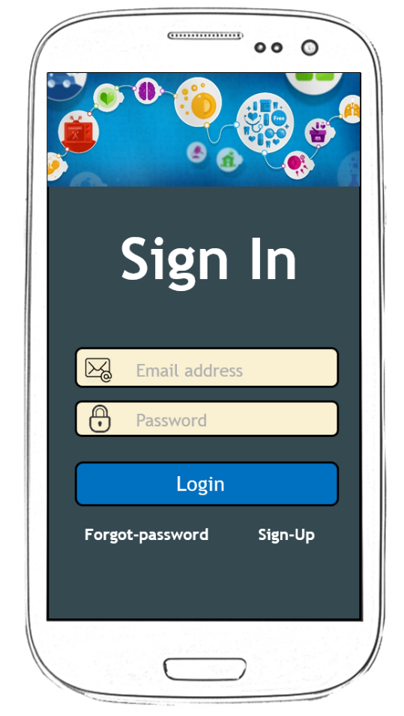
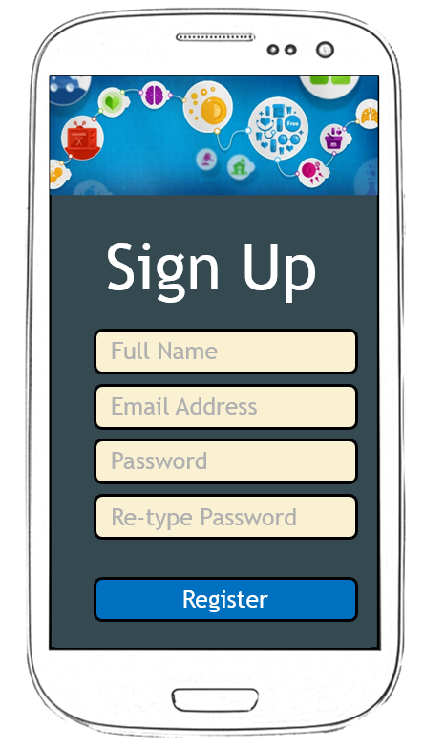
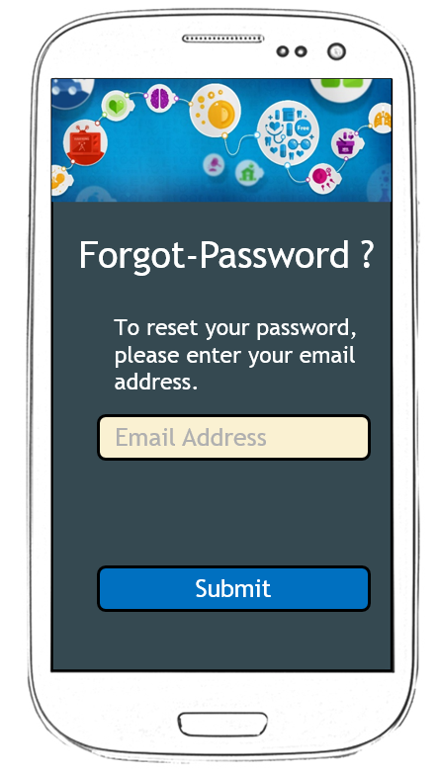
Sign Un, Sign In and Forgot Password Screen

Slide 4















Home Page
Home
Home
Profile
Find Services
Loading ..
Remainders
Appointments
Call for help
Useful Links
Send Feedback
About the app

Slide 5






Profile
Profile
Change Picture
Jomin George
Last Login: Thursday, February 29, 2016, 15:20:13
Gender
Language
Email Address
Contact Number
Done

